Slide 1
Use Case 1: Predict Customer Success
Olivia Larrea
Apurva Shetty
Niha Garikapati
Notes:
"Good evening, everyone. It’s our pleasure to be here today to present our final capstone project on Swire Coca-cola’s Use case 1: Predicting Customer success. My name is Niha, this is Apurva and Olivia. And together we would be sharing an overview of our project.

Slide 2
Overview of the Presentation
Objectives
Methodology
Model Selection
Deployment and Evaluation
Final Recommendation
Future Steps
Notes:
We begin the overview of our presentation with a brief objective of what we are trying to solve followed by the approach we used to do the same.
Next, comes the different models we fit based on the project needs.
Followed by implementing the model along with accessing their performance for Final Recommendations and Future steps.

Slide 3
Overview of the Presentation
Objectives
Methodology
Model Selection
Deployment and Evaluation
Final Recommendation
Future Steps

Slide 4


Discounts
Notes:
As we know 10% of of Swire’s business is “B2B”. So whenever there is a new business in the market Swire would need to win it over by giving discounts.
So we started wondering what Swire actually needs to be successful. Understanding the challenge here is to predict the success of new businesses launched in the market.

Slide 5



Key Factors of Success
Customer relations/communications
Operational excellence
Financial management
Notes:
As a general idea of a successful business there are broadly 3 key factors namely –
Operational excellence
Customer relations/communications
Financial management
Success of which can be predicted through either Longevity, Popularity or Sales Volume.

Slide 6
Overview of the Presentation
Objectives
Methodology
Model Selection
Deployment and Evaluation
Final Recommendation
Future Steps

Slide 7
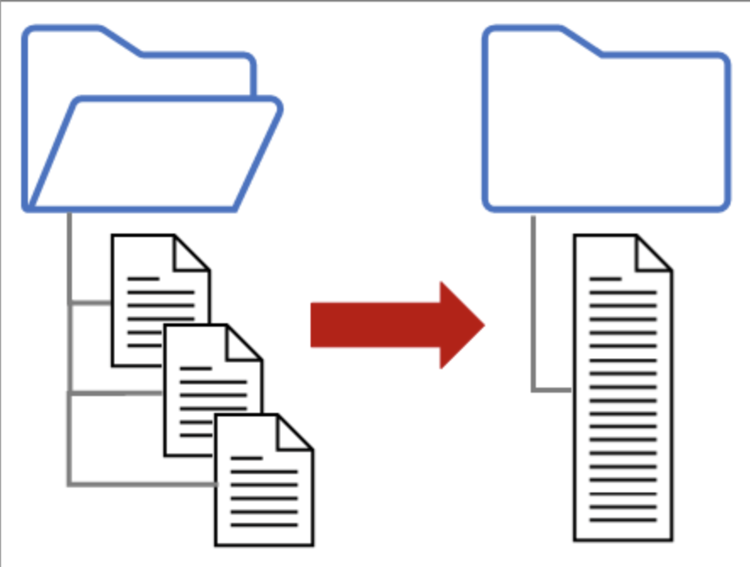

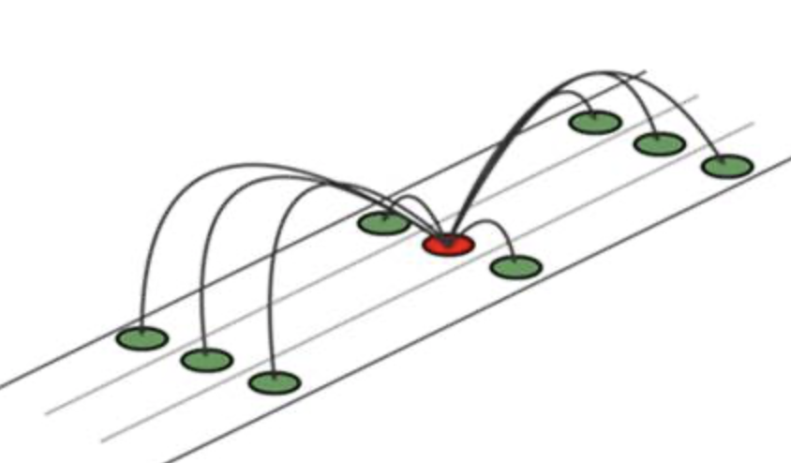
Data Pre-processing
Merging
Cleaning
Imputation
Notes:
We pre-processed the data by first merging the Customer and Sales data to give us a unified Customer – Product dataset which is on the product-level.
We later combined the demographic information which we got from the public platform. This we achieved by separating the Address zip code column which contained the ZIP code + FIPS code at a product-level. So in simple words what Address zip code column contains is information a specific location along with information of a specific region in that location. So, as we wanted to combine location wise information we split the Address zip code into two different columns Address code and Zip code and merged the population and density information Zip code wise .
On further inspection we found few discrepancies in columns such as ON_BOARDING_DATE which had obvious error.
We used the median/mode method for imputing missing values.
Other steps in pre-processing were to drop few columns such as Address code, state_id and state_name due to low variance.

Slide 8


Data Preparation
Sales Volume
Longevity
Notes:
This step onwards we actually combine the individual efforts of our team to better answer the business problem of predicting the overall success. We split our efforts of prepping and modelling for the two metrics Sales Volume and Longevity.

Slide 9
Sales Volume
Notes:
We have taken into account the two years dataset to predict sales volume.

Slide 10
Data Preparation
Grouping Data
Cost of the Product
Discount Offered
Notes:
Starting with the data preparation we grouped the data on a product level by taking medians for each package along with calorie and beverage categories.
We feature engineered the cost of the product by taking into account physical volume sold. This was attained by initially dividing the total cost of goods for materials sold during the whole timeframe by physical volume sold. Later taking the median of the same during grouping the data.
Similarly we feature engineered Discount offered on each product by dividing it by physical volume sold, later taking the median of the same during grouping the data.

Slide 11
Data Dictionary
Package type description
Beverage Category
Physical Volume
Calorie category
Discount
Cost of the product
Notes:
We have considered only these input variable for modelling Sales Volume as only these best explain the model. Among all the predictors initially in the dataset only these add information to the model such as – description of the package, Categories of Beverage and calorie along with information about discounts and feature engineered cost of the product.

Slide 12
Overview of the Presentation
Objectives
Methodology
Model Selection
Deployment and Evaluation
Final Recommendation
Future Steps

Slide 13
Model Selection
Linear Regression
Regularized Linear Regression
Decision Trees
Random Forest
Notes:
These are models considered for Sales Volume prediction.

Slide 14
Overview of the Presentation
Objectives
Methodology
Model Selection
Deployment and Evaluation
Final Recommendation
Future Steps

Slide 15
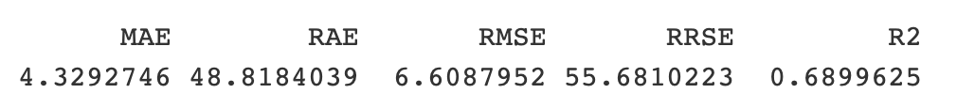
Linear Regression

Slide 16
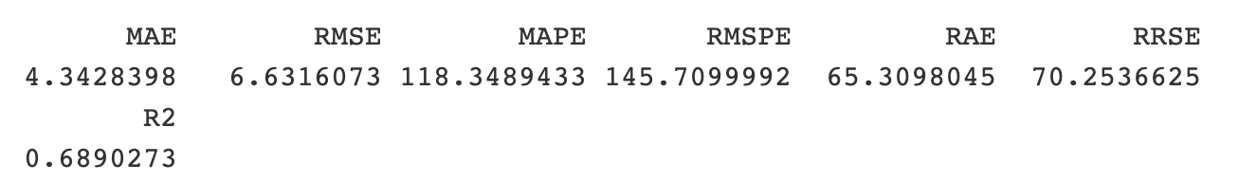
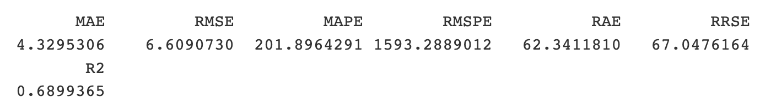
Regularized Linear Regression
Ridge
Lasso

Slide 17
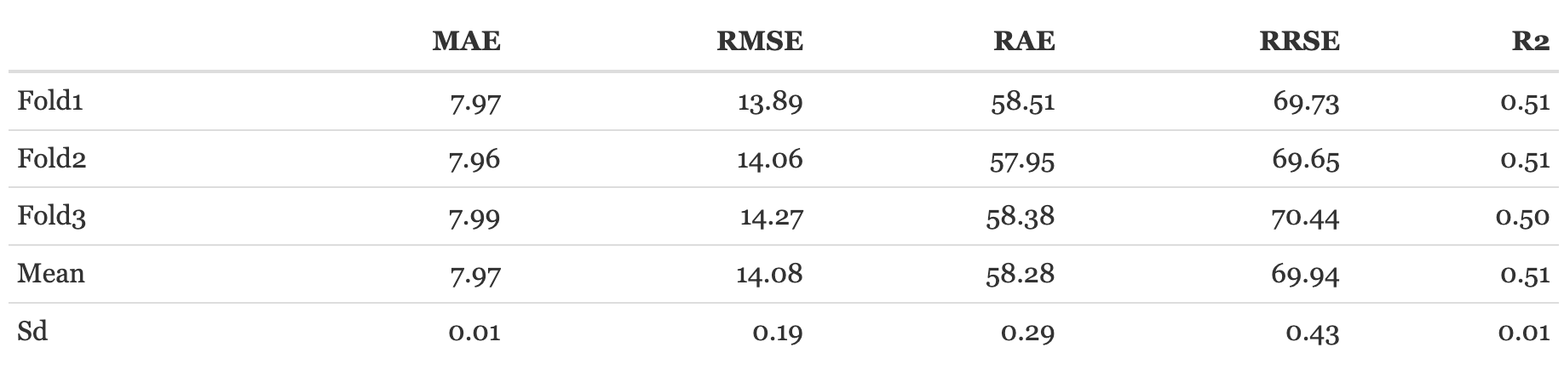
Decision Tree
Cross Validation with Tuning
Notes:
In an attempt to make the model better we played with the control factors of the decision tree that is nothing but changing the cp value, the minimum split and minimum bucket size to get cross validated evaluation. As you can see the evaluation does look like it has improved the model as compared to the regression models having a much lower R squared and higher RMSE value.

Slide 18
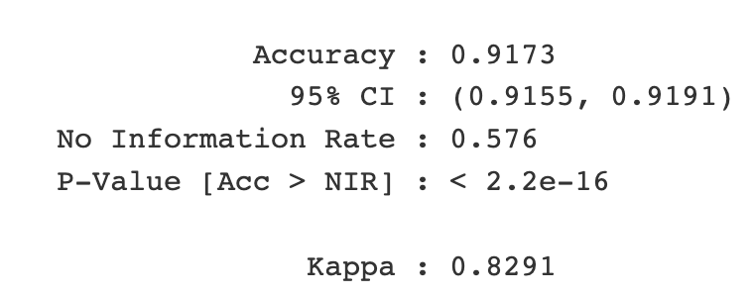
Random Forest
Notes:
As we did not not have any luck modelling using the decision tree we went forward with a more robust modelling technique : the random forest which would limit overfitting along with errors due to bias and achieve the final result. In this particular case the hyper tuning in the model was done by changing the ntree value to 250 other the default value of 500 along with finding the best mtry value limit overfitting as well as errors due to bias and achieve the final result. limit overfitting as well as errors due to bias and achieve the final result.to further reduce the oob error.

Slide 19
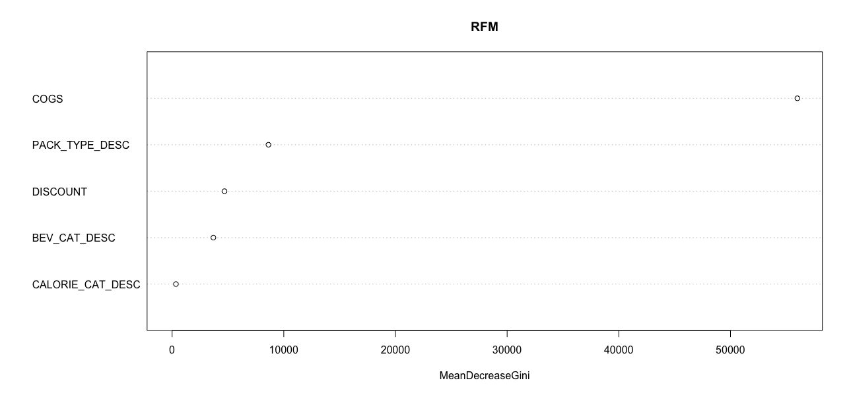
Summary: Factors affecting Sales Volume
Notes:
To sum up the modelling and evaluation these are the top factors effecting Sales Volume namely COGS (which in this case is the feature engineered Cost of the product) followed by Package type, discount and beverage and calorie categories.

Slide 20
Longevity
Notes:
Coming to the other metric of business success.

Slide 21
Data Preparation
Grouping Data
Longevity
Notes:
Unlike Sales Volume we prepared the data on a customer level by aggregating number of transactions and physical volumes sold.
We also feature engineered the target variable Longevity by finding out the length of the transaction using the minimum and maximum posting dates. Later dividing it with the number of transactions to give us a length of successful transaction of each customer.

Slide 22
Data Dictionary
Demographics
Number of Transactions
Physical Volume
Sales Office Description
Activity Cluster
Trade Channel
Notes:
We have considered only these input variables as they better define the model for Longevity. Like the location of the Sales office, Activity cluster and trade channel of the customer along with number of transactions and physical volume. We have also taken into account the demographics of each location to better model the length of successful transaction.

Slide 23
Overview of the Presentation
Objectives
Methodology
Model Selection
Deployment and Evaluation
Final Recommendation
Future Steps

Slide 24
Model Selection
Linear Regression
Regularized Linear Regression
Decision Trees

Slide 25
Overview of the Presentation
Objectives
Methodology
Model Selection
Deployment and Evaluation
Final Recommendation
Future Steps

Slide 26
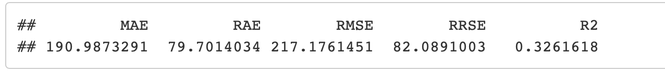
Linear Regression

Slide 27
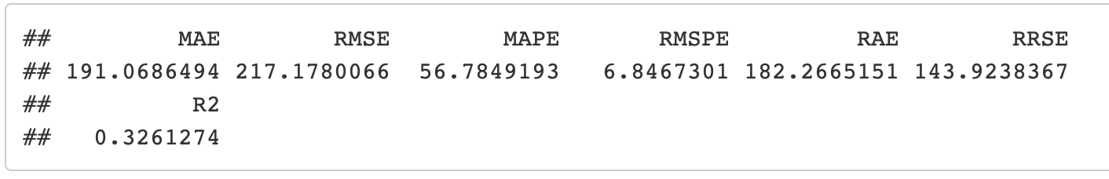
Regularized Linear Regression
Ridge
Lasso

Slide 28
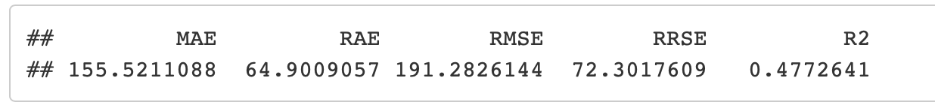
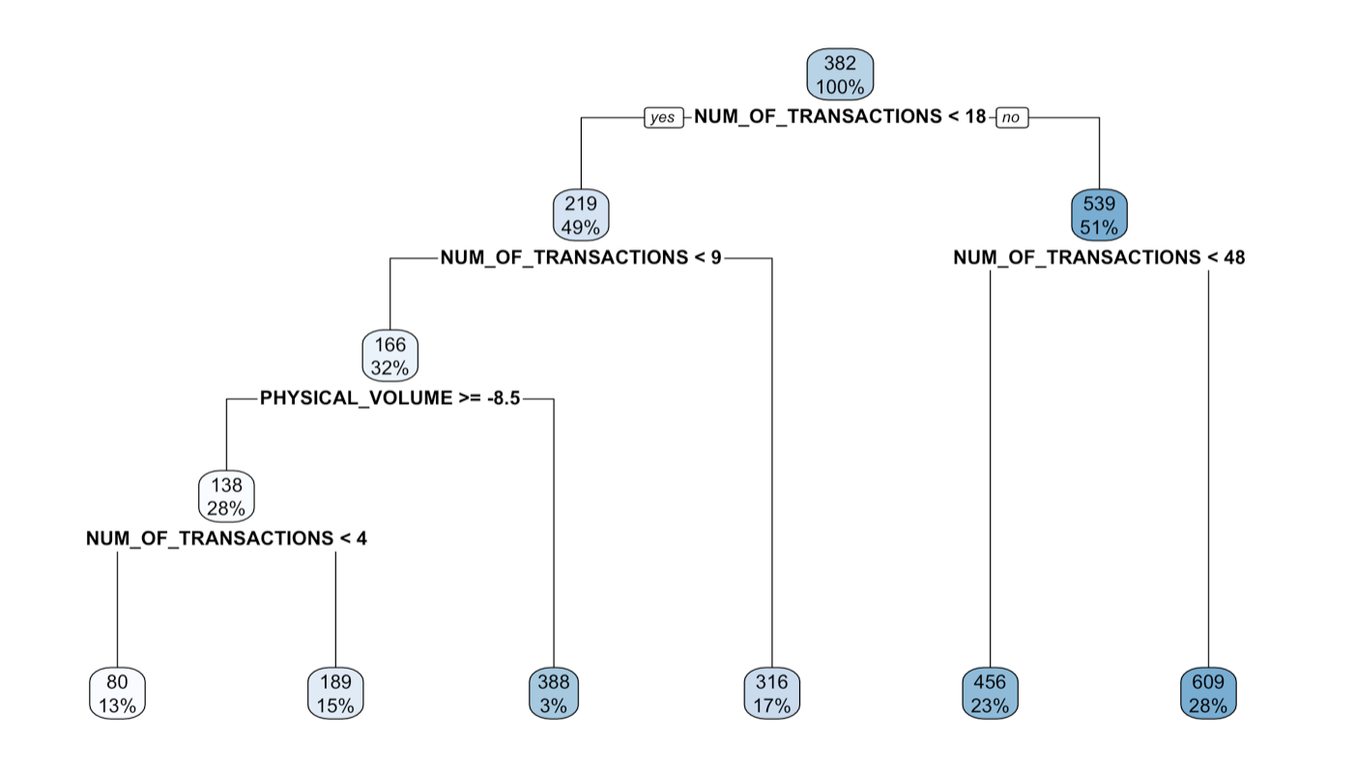
Decision Trees

Slide 29
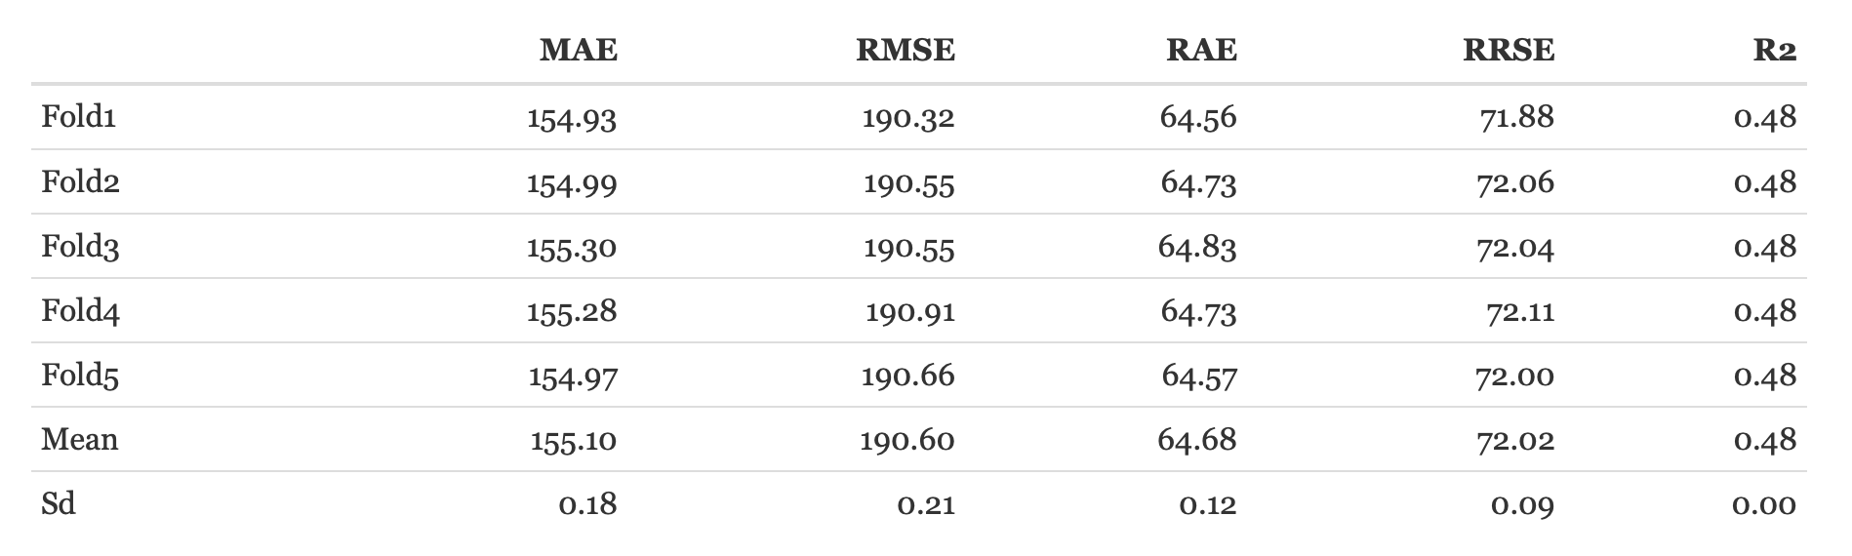
Tuned Decision Trees

Slide 30
Summary: Factors affecting Longevity
Number of Transactions
Physical Volume
Customer Trade Channel

Slide 31
Executive Summary
Pricing product categories
Discounts on product categories
Estimating successful long lasting business

Slide 32
Overview of the Presentation
Objectives
Methodology
Model Selection
Deployment and Evaluation
Final Recommendation
Future Steps
Notes:
We begin the overview of our presentation with a brief objective of what we are trying to solve followed by the approach we used to do the same.
Next, comes the different models we fit based on the project needs.
Followed by implementing the model along with accessing their performance for Final Recommendations and Future steps.

Slide 33
Final Recommendations
Combining the effecting factors
Modeling with weightage
Modeling as a qualifier

Slide 34
Overview of the Presentation
Objectives
Methodology
Model Selection
Deployment and Evaluation
Final Recommendation
Future Steps

Slide 35
Future Steps
Adding Popularity
Customize discounts based on Trade channel
In depth analysis on Pack Type description

Slide 36
Any Questions?
Notes:
1. How are we going to share the git – we need emails to give everyone access.
2. Is the overview covering everything, do you think we missed anything.
3. Is font ok?
4. Do we follow the same format for documentation, is there a limit on how much we should add in the doc.
5. Do we have to mention individual contributions in the doc. Sample documents
6. Do we include code in the doc
7. Are the pictures in the slides fine
8. Do you think we followed the presentation guideline

Slide 37
Thank you!!

